Slide 1
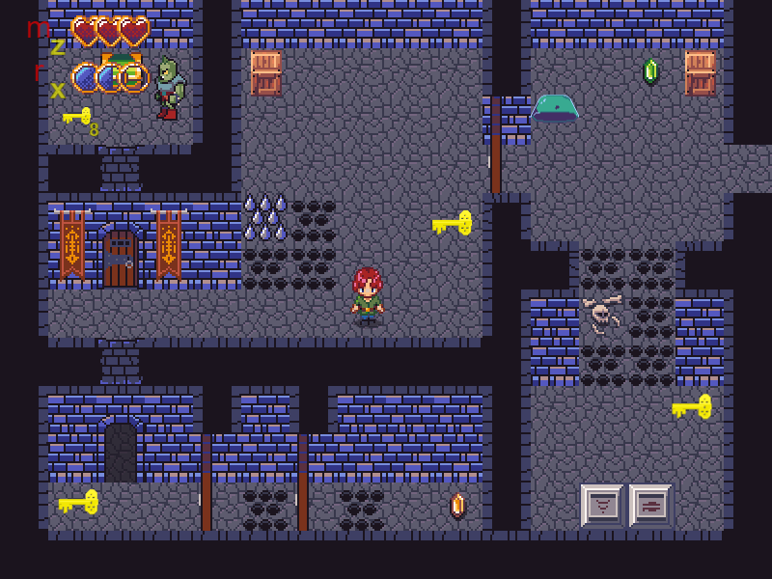
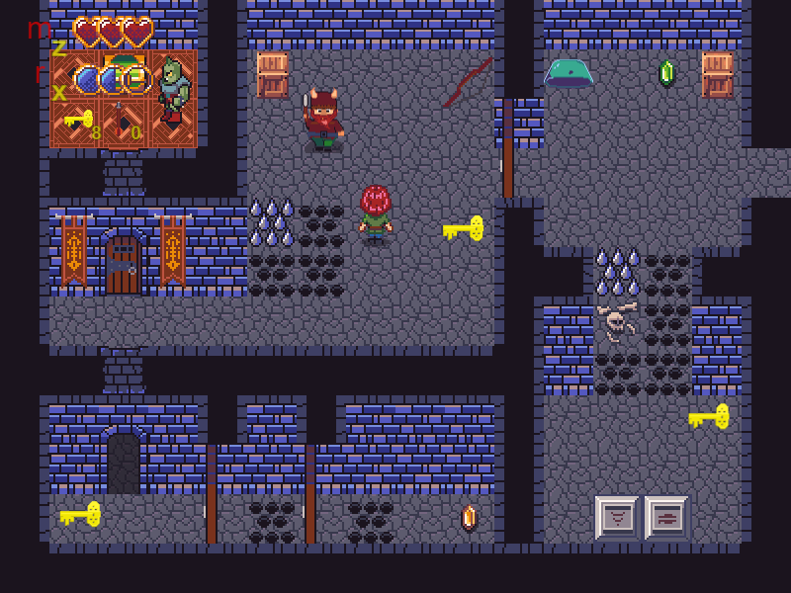
Dagger’s Gate
Pitch Date: 1/31/2021 Today: 2/28/2021 3:40 PM EST
Release Date: 5/23/2021
Team Lead: Vince McKeown 179 Commits total, 39 Week 4

Slide 2

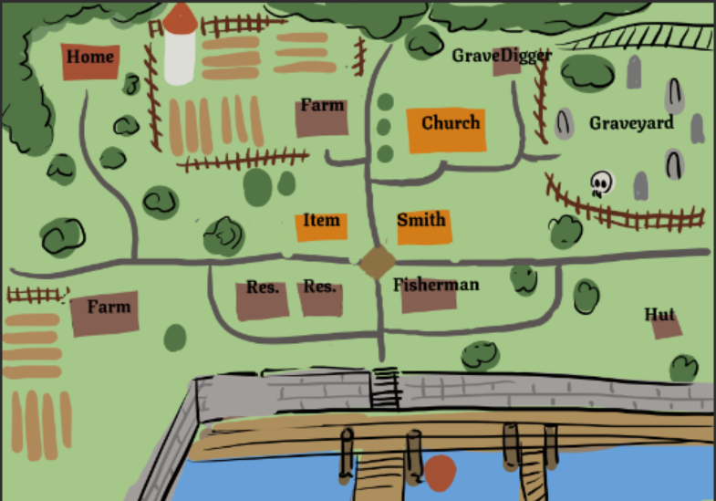
Contributors this week: Kyle Knutson

Slide 3
Contributors this week: Tylor Allison
Layering for Draw Code
Ranged Attacks
Melee Animations
Tile Editor
Bug Fixes

Slide 4

Contributors this week: Vince McKeown
Pathfinding Patches

Slide 5
Contributors this week: Kulesko
Connected Sound to enemy hit

